Slide 1
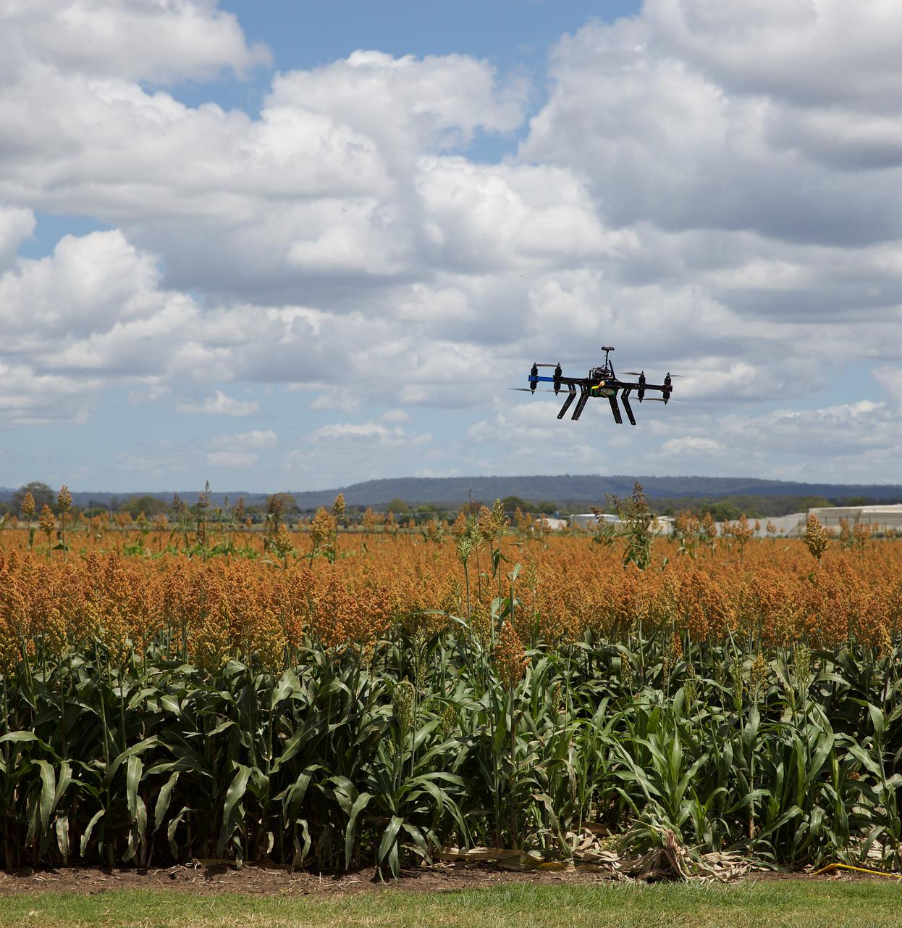
Precision Farming Using Autonomous Vehicle
Group A1: Arsany Girgis
Jaouaher Belgacem Jasmeet Singh Matta
[1]
Notes:
Line spacing + Page numbers

Slide 2
The Software Modelling

Slide 3
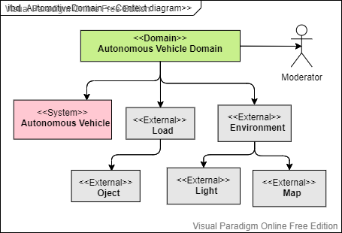
Context Diagram

Slide 4
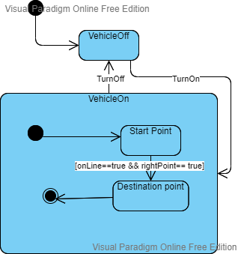
State MachineDiagram

Slide 5
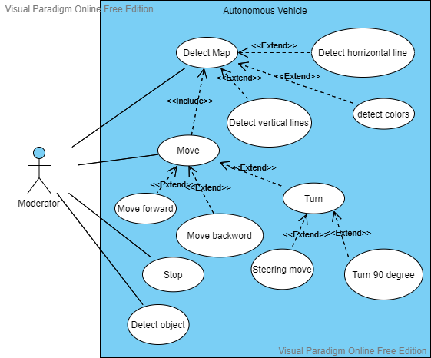
Use Case Diagram

Slide 6
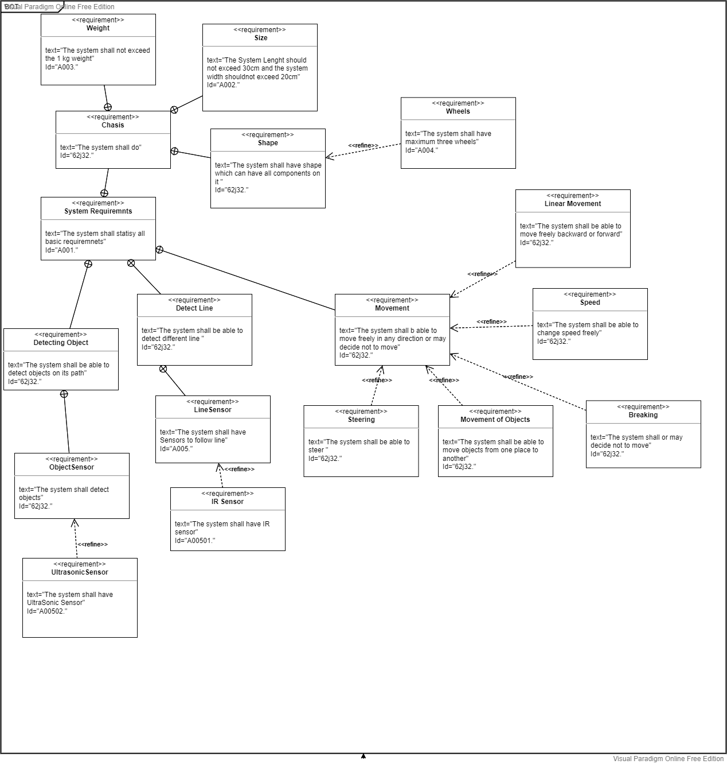
Requirement Diagram

Slide 7
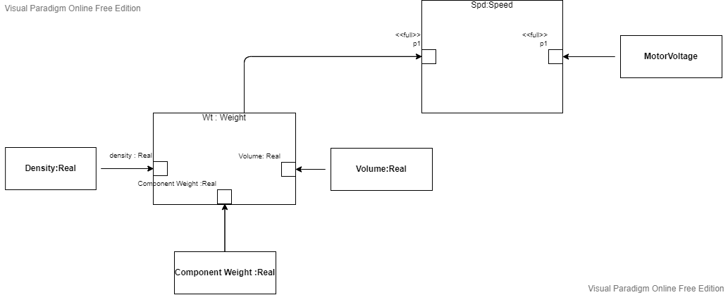
Parametric Diagram

Slide 8

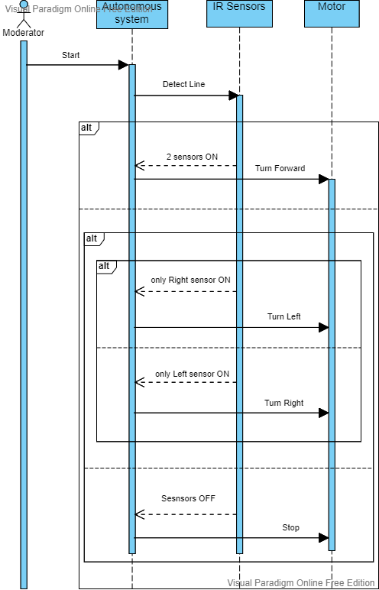
SequenceDiagram

Slide 9
The Hardware Modelling

Slide 10
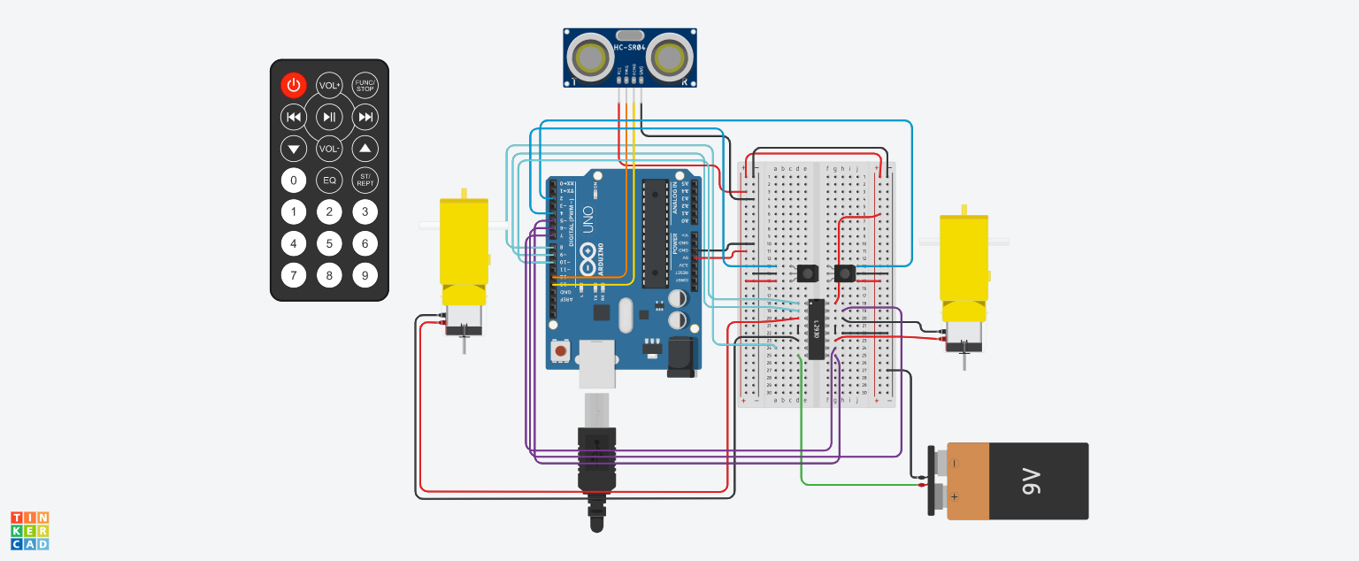
TinkerCad simulation

Slide 11

Design Inspiration
[1]

Slide 12
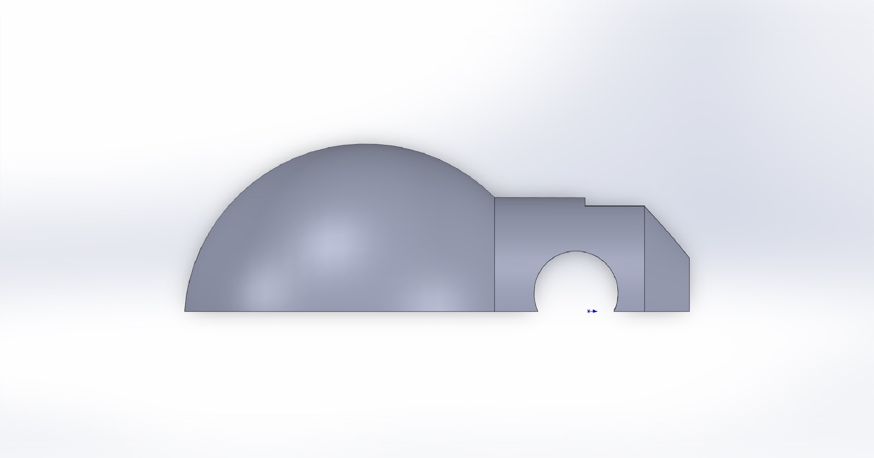
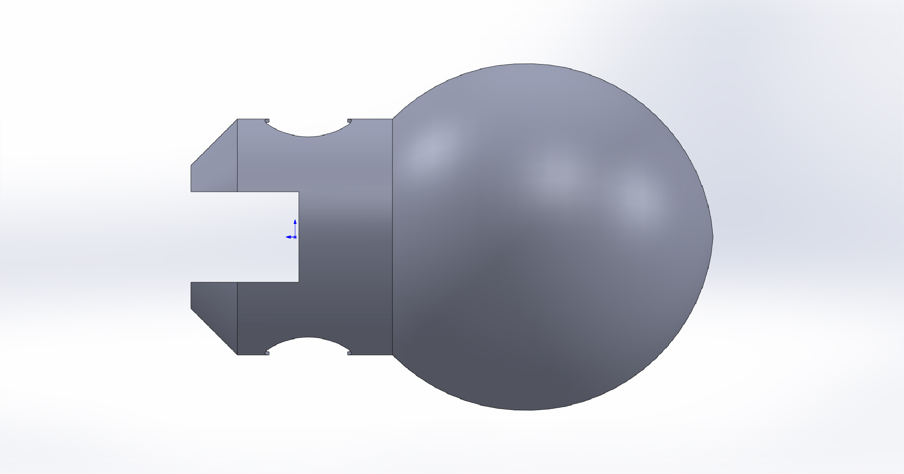
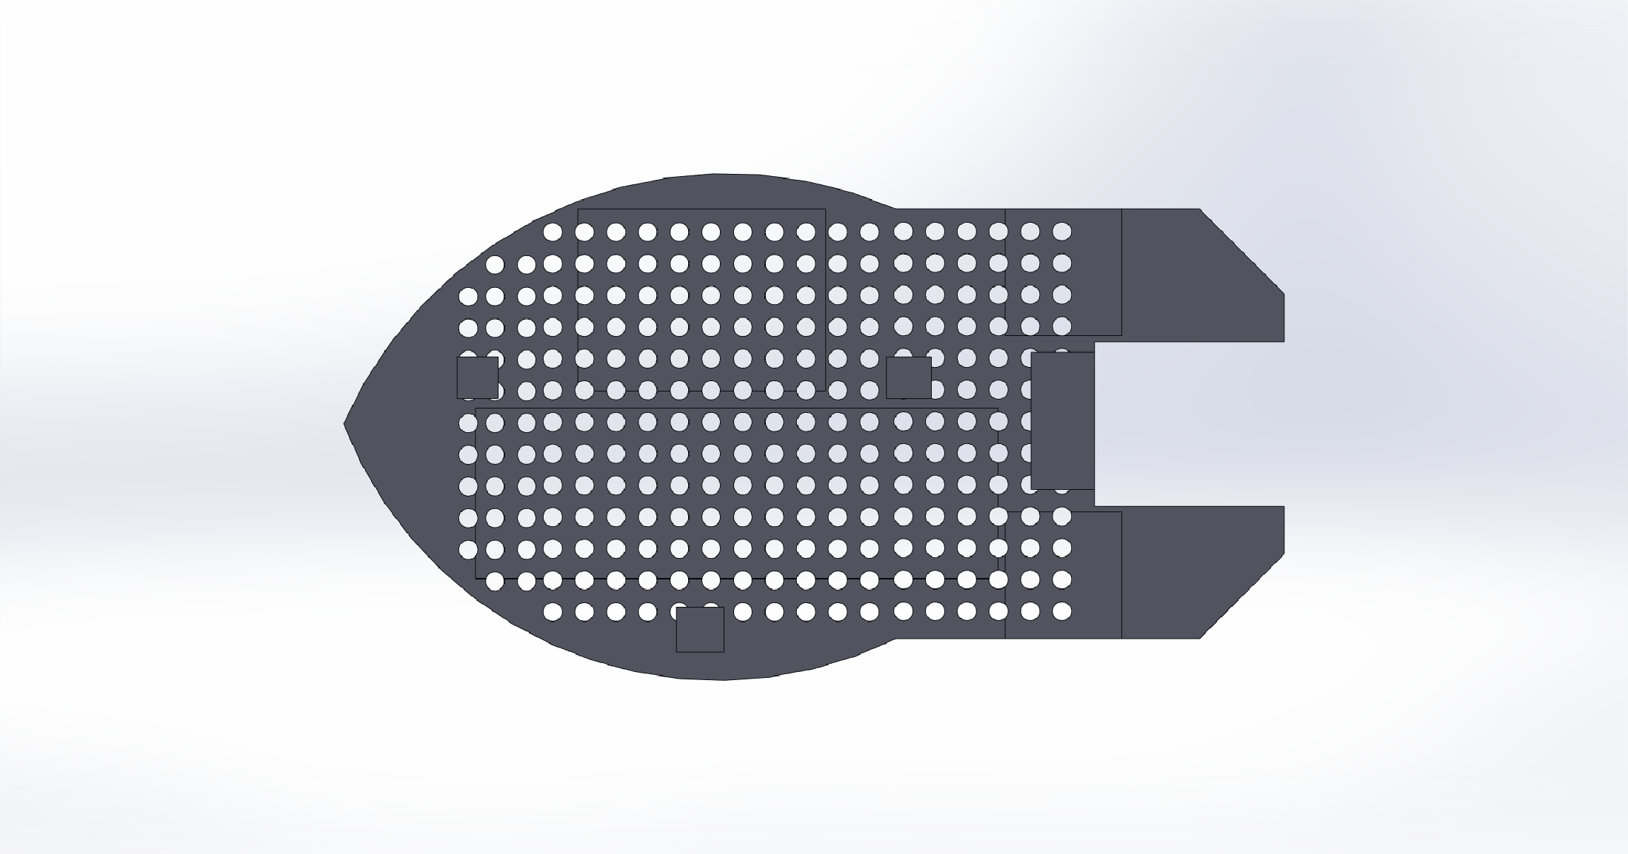
Design
[1]

Slide 13
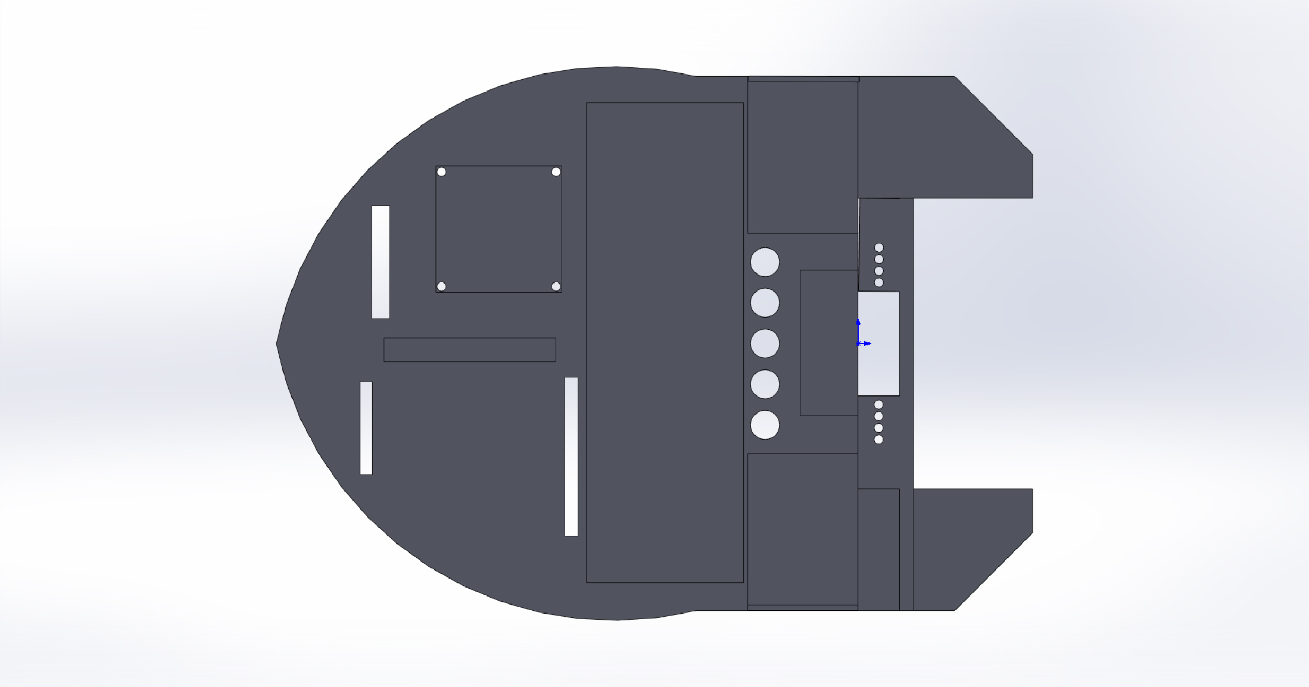
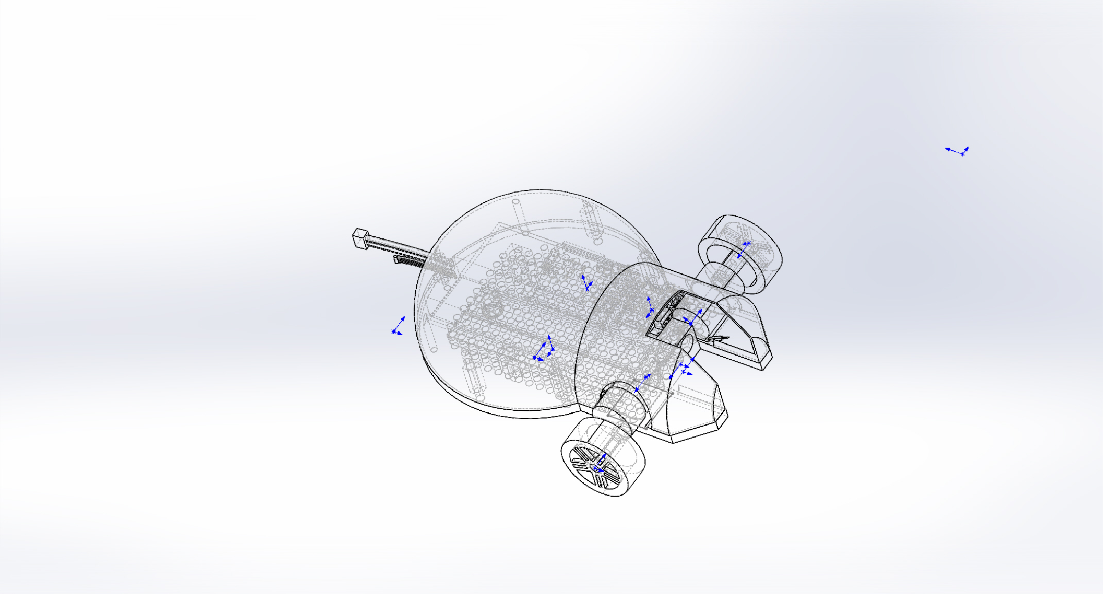
Design
[1]

Slide 14
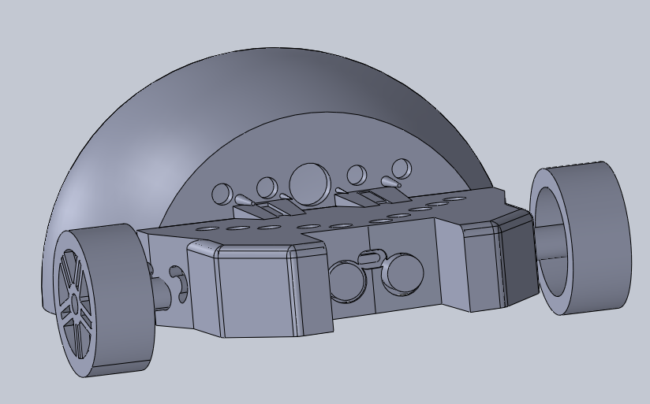
Final Design

Slide 15
Code Implementation

Slide 16
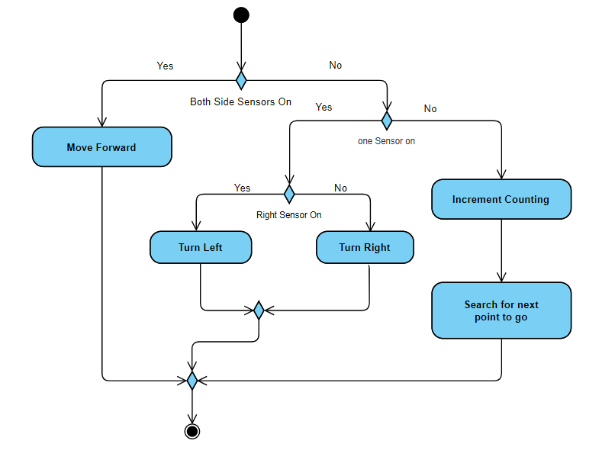
Line Follower Activity Diagram

Slide 17
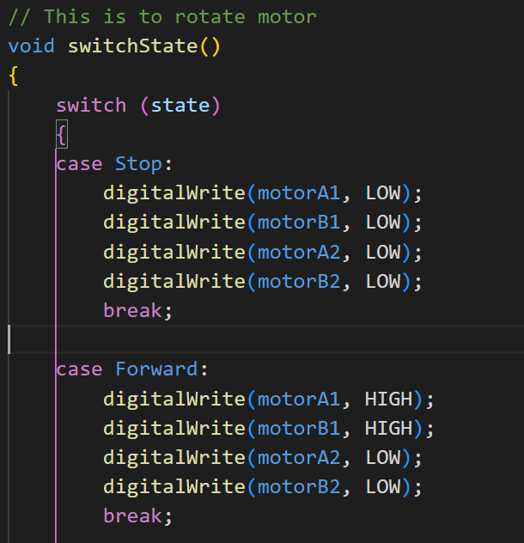
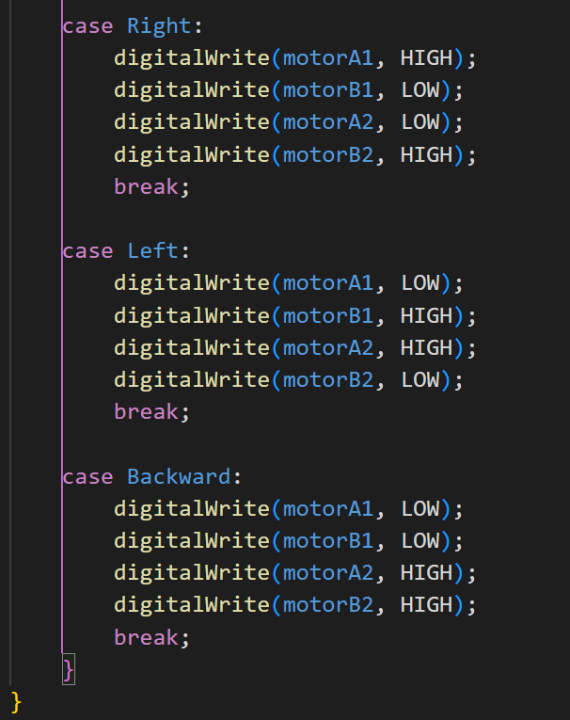
Motor Pins Configuration

Slide 18
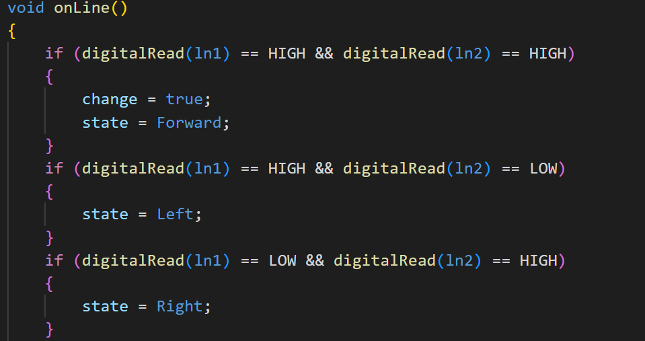
Line Follower Logic

Slide 19
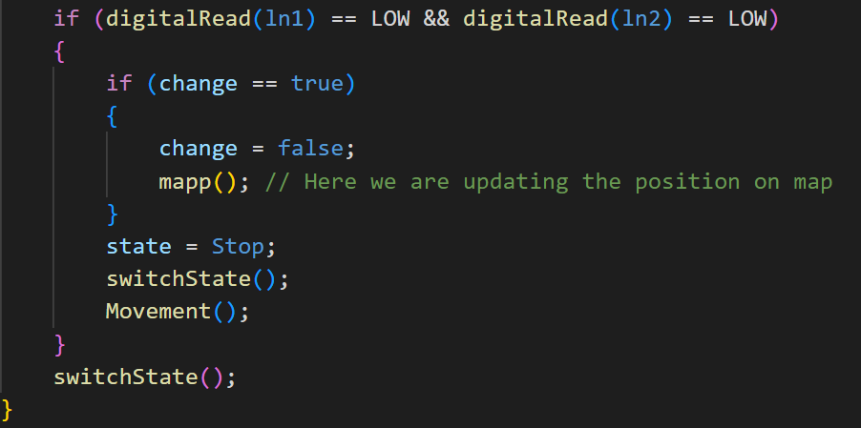
Line Follower Logic

Slide 20
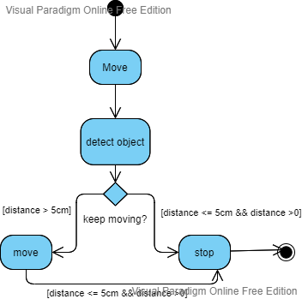
Object Detection

Slide 21
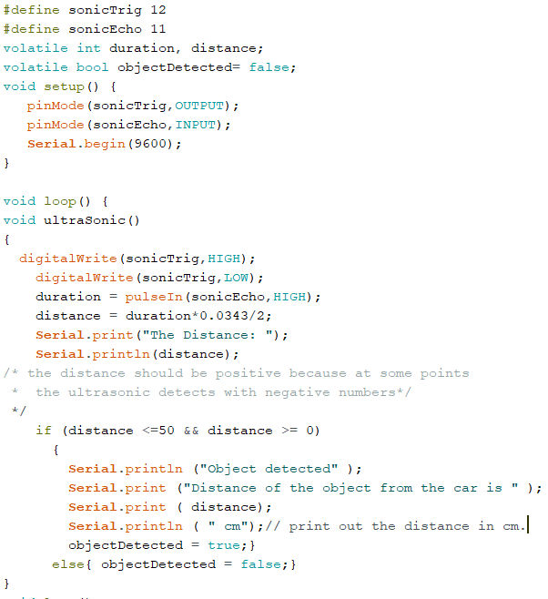
Object Detection

Slide 22
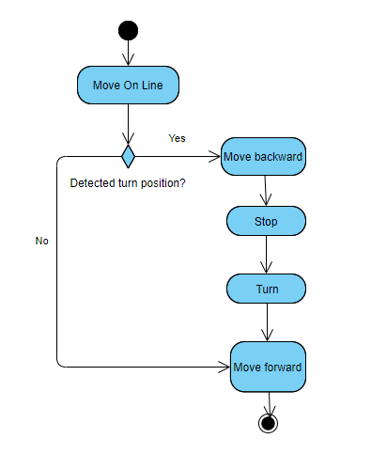
90° Turn

Slide 23
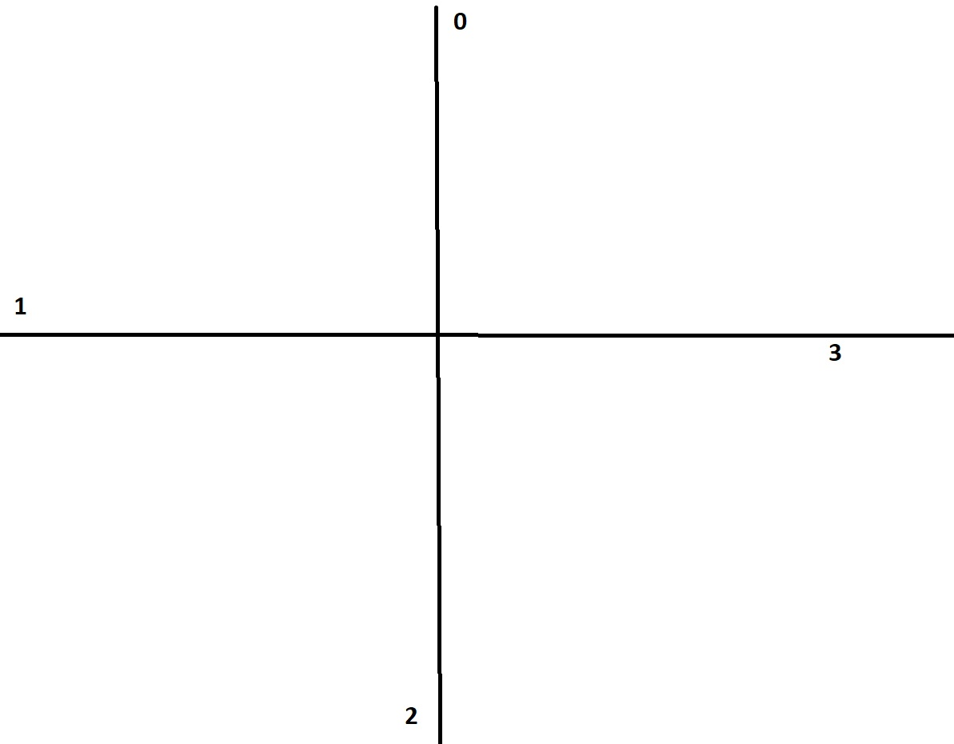
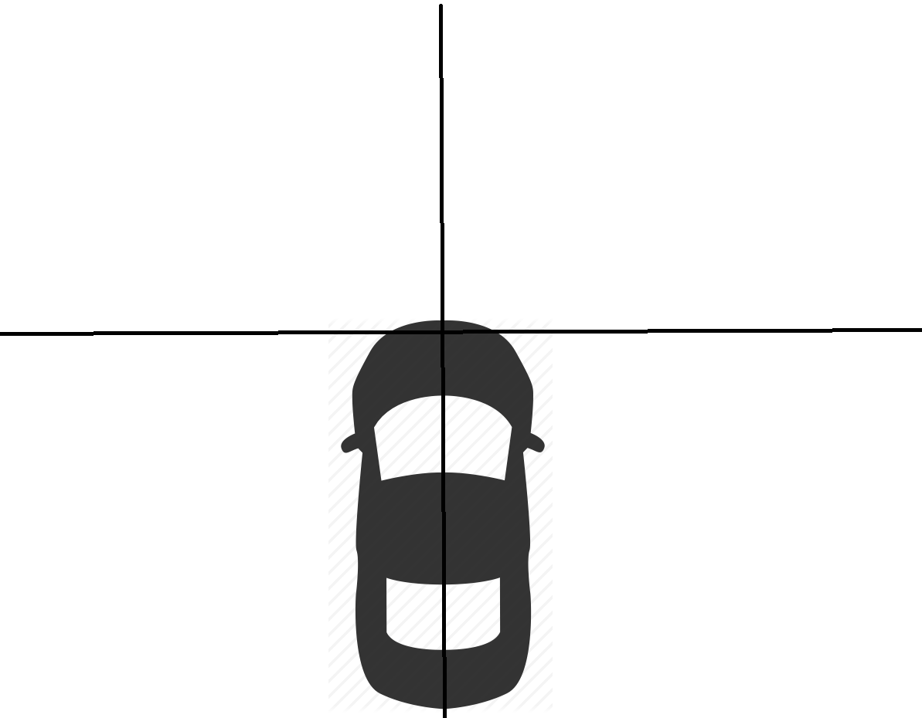
Mapping

Slide 24
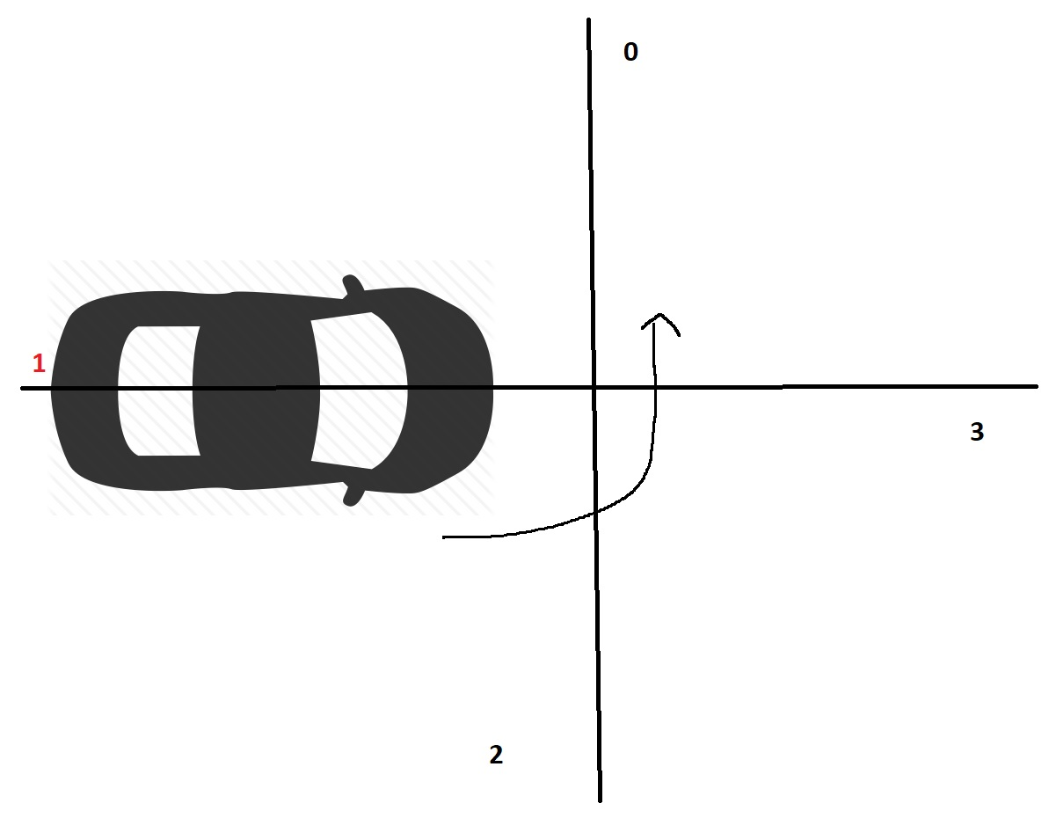
Algorithm

Slide 25
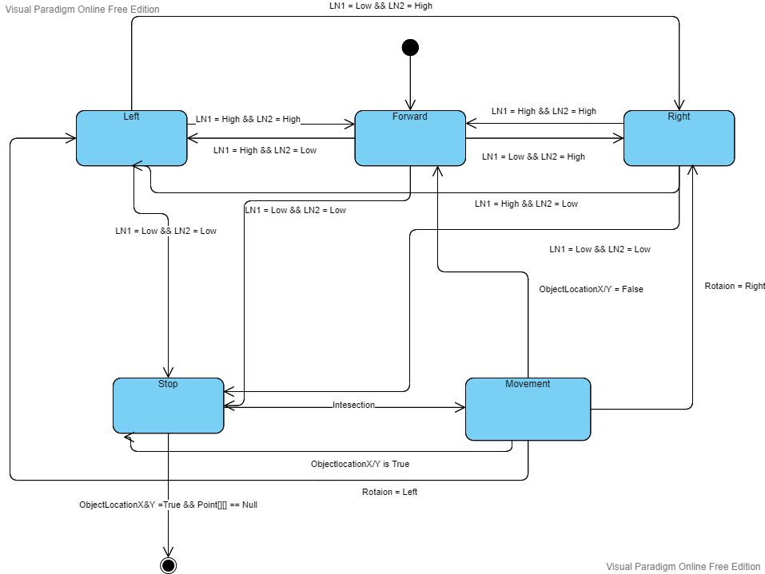
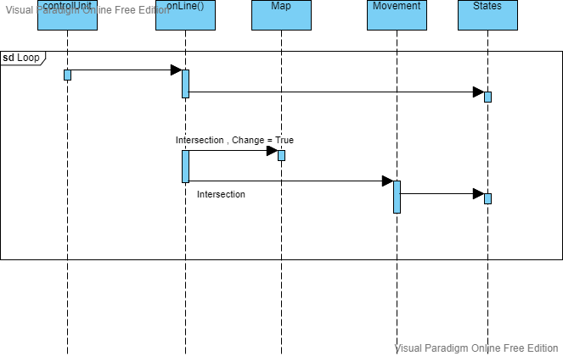
Algorithm

Slide 26
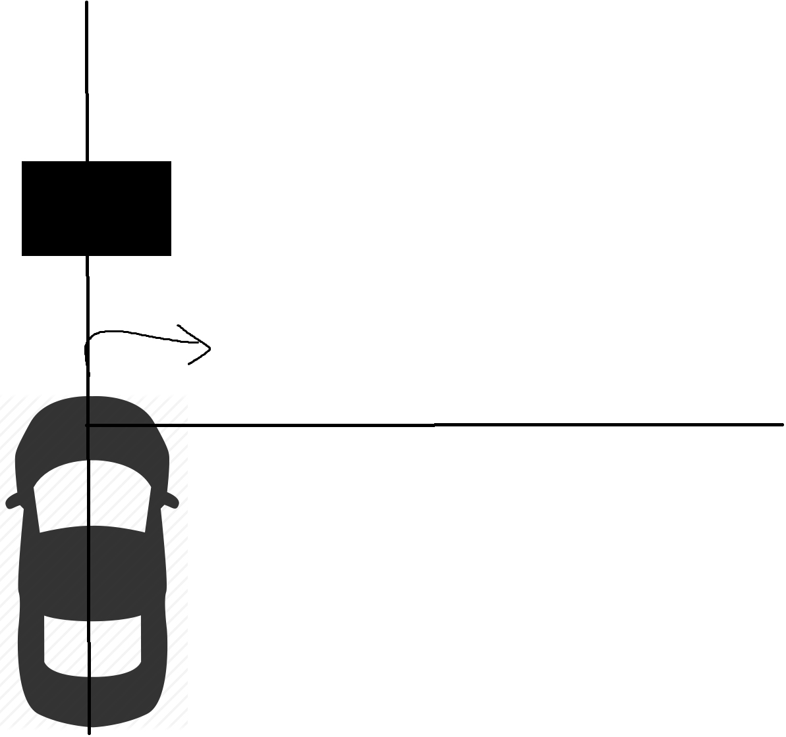
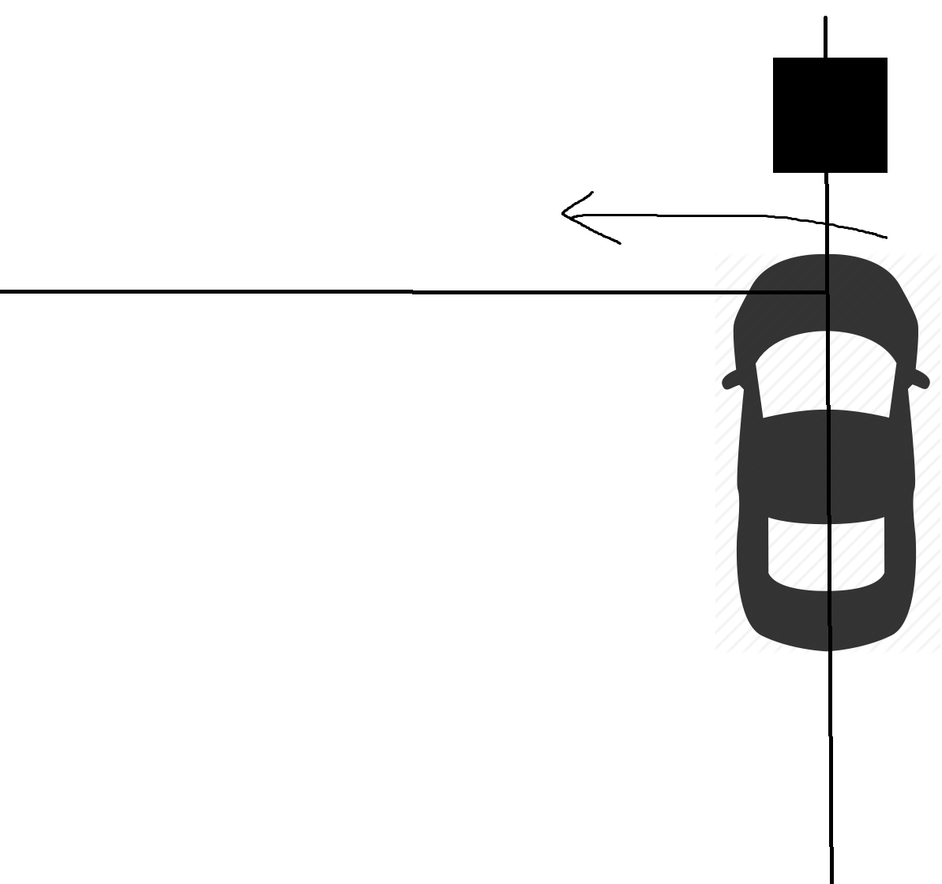
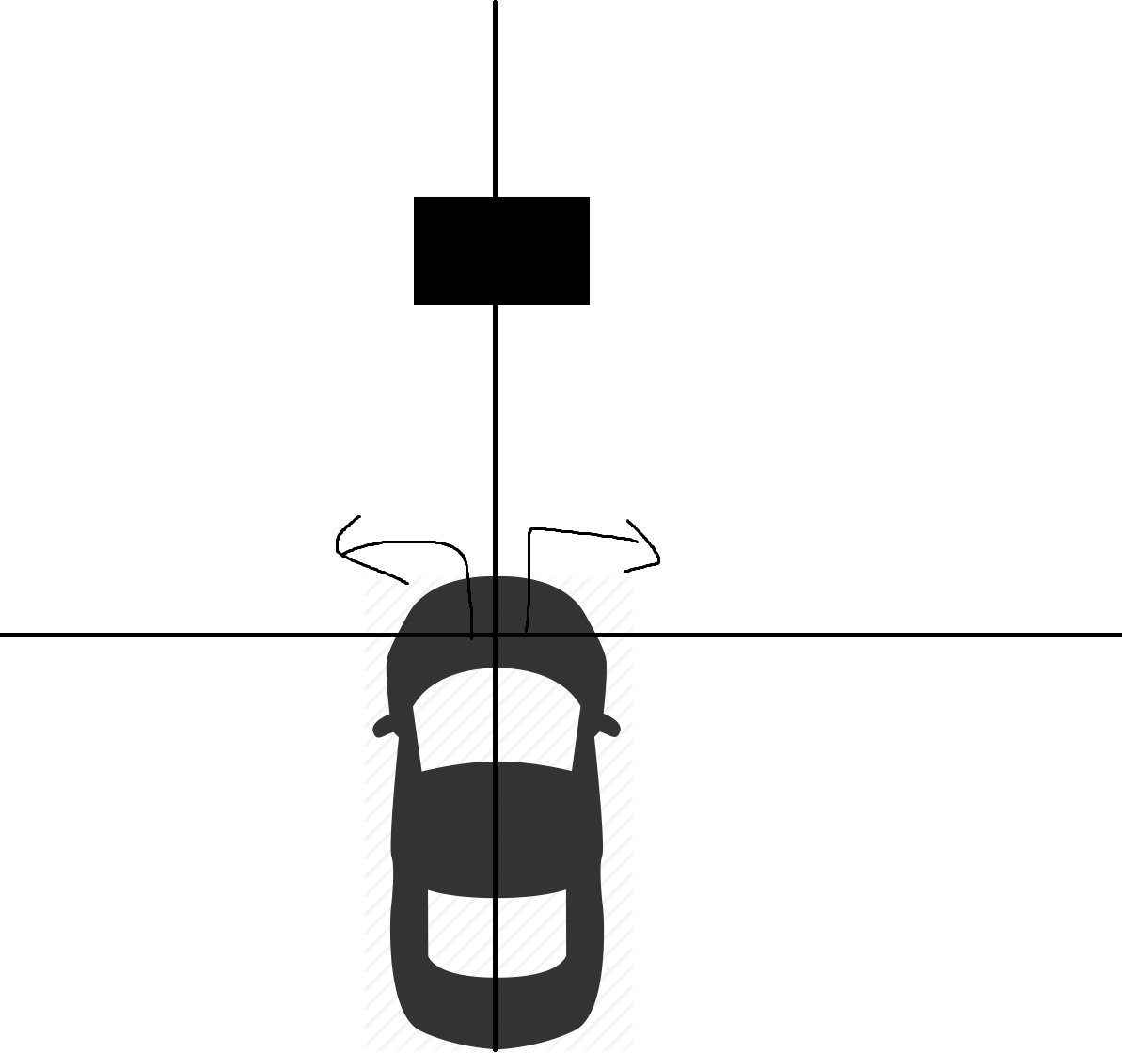
Obstacle Avoidance

Slide 27
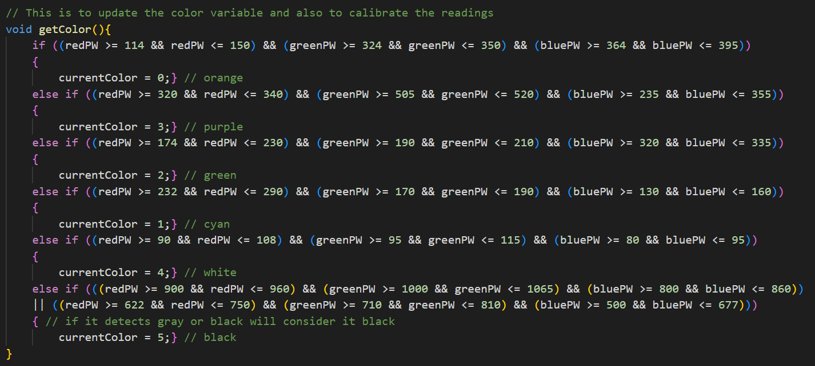
Color Detection

Slide 28
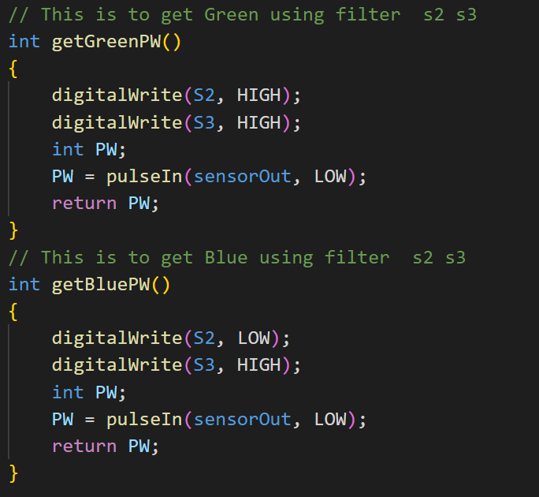

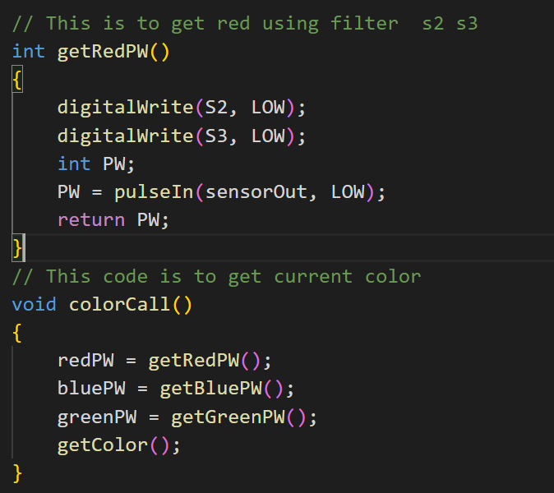
Color Detection

Slide 29
Sources
1: pixabay.com

Slide 30
THANK YOU FOR YOUR ATTENTION

